Slide 1
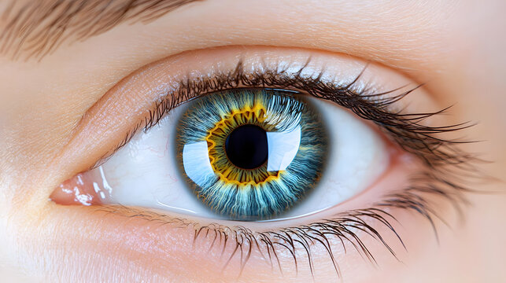
Enhancing Glaucoma Detection with Convolutional Neural Networks

Slide 2

Enhancing Glaucoma Detection with Convolutional Neural Networks
Supervisor
Md. Ashraf Ali
Farjana Yemin Opi

Slide 3
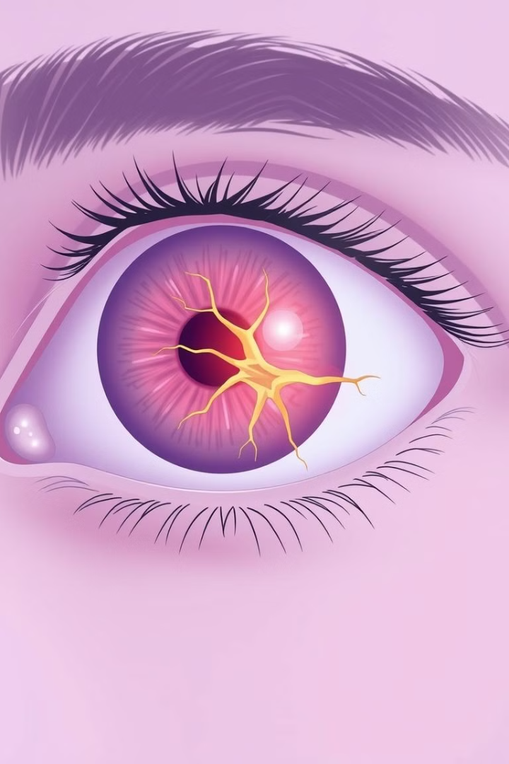
The Global Glaucoma Challenge
What is Glaucoma?
Why Focus on Detection?
A group of eye conditions that damage the optic nerve, often linked to increased eye pressure.
Early diagnosis is crucial to prevent vision loss. Traditional methods have limitations in cost, scalability, and accessibility.
Global Impact
76 million people affected by glaucoma (2020) with projections reaching 112 million by 2040.

Slide 4
Learning from the Past: Traditional vs. Modern Approaches
Traditional Approaches
Deep Learning Advances
Machine learning models like SVM and Decision Trees. Handcrafted features (e.g., cup-to-disc ratio). Limited generalizability across diverse datasets.
CNNs remove the need for manual feature extraction. Outperform traditional methods in medical image analysis.

Slide 5

Our Mission: Smarter Glaucoma Detection
1
Objective
2
Techniques
Develop a CNN-based framework for accurate and efficient glaucoma detection. Create a lightweight architecture optimized for mobile and edge devices.
Data augmentation, transfer learning, and hyperparameter optimization.

Slide 6
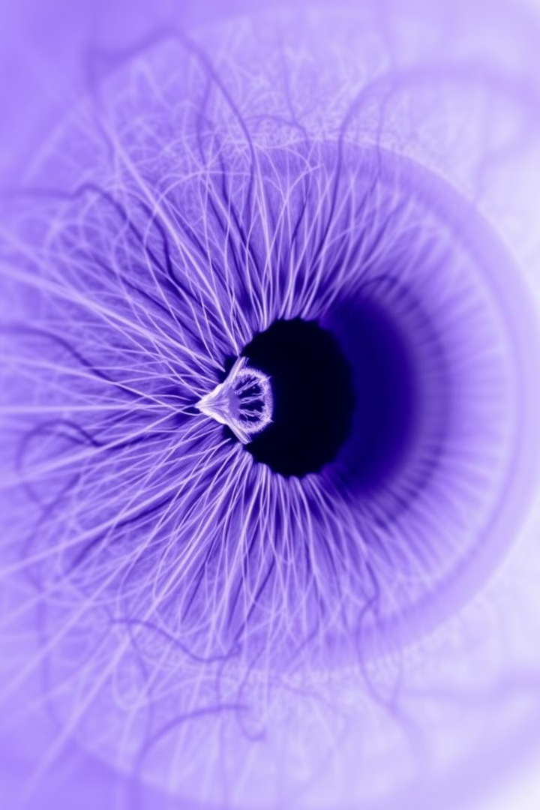
Dataset Overview
The Kaggle Glaucoma OCT Images Dataset was used, containing images categorized into normal and advanced glaucoma conditions. This dataset provides a valuable resource for training and evaluating the CNN model.

Slide 7
Developing the Solution: A Systematic Approach
Data Collection
1
Source: Kaggle Glaucoma OCT Images Dataset. Images categorized into normal and advanced glaucoma conditions.
2
Preprocessing
Resize images to 224×224 pixels. Enhance features using noise reduction, edge detection, and sharpening. Normalize pixel values to [0, 1]. Encode labels for binary classification.
Model Development
3
Custom CNN with convolutional layers, pooling layers, dropout layers, fully connected layers, and a softmax output layer.
4
Training and Validation
Dataset split: 70% training, 30% validation (stratified sampling). Early stopping to avoid overfitting.
Evaluation
5
Metrics: Accuracy, precision, recall, F1-score, AUC-ROC. Confusion matrix for detailed analysis.

Slide 8
Key Takeaways & The Road Ahead
Main Findings
1
The proposed CNN-based framework achieved high accuracy and computational efficiency. Successfully addressed real-world challenges like variability in datasets and resource limitations.
Future Scope
Expand dataset diversity to enhance robustness. Integrate explainability features to aid clinicians in understanding model predictions. Deploy the model on edge devices and validate in clinical settings. Explore other ophthalmic conditions using similar AI-driven approaches.
2

